Slide 1

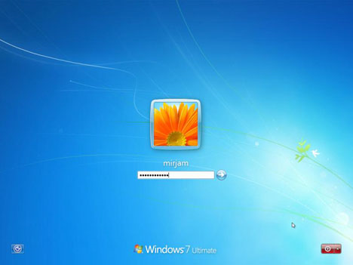
Authentication & Authorization in ASP.NET
Forms Authentication, Users, Roles, Membership
Ventsislav Popov
Crossroad Ltd.

Slide 2


Table of Contents
Basic principles
Authentication Types
Windows Authentication
Forms Authentication
Passport Authentication
Users & Roles
Membership and Providers
Login / Logout Controls

Slide 3
Basics
Authentication
The process of verifying the identity of a user or computer
Questions: Who are you? How you prove it?
Credentials can be password, smart card, etc.
Authorization
The process of determining what a user is permitted to do on a computer or network
Question: What are you allowed to do?
Notes:
Authentication - This is the process of accepting credentials from a user and validating those credentials against a designated authority. The user's (or potentially an application's or computer's) identity is referred to as a security principal. The client must provide credentials to allow the server to verify the identity of the principal. After the identity is known, the application can authorize the principal to access resources on the system.
Authorization - This is the process of determining whether the proven identity is allowed to access a specific resource.

Slide 4

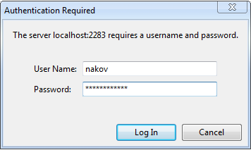
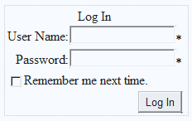
Windows and Form Authentication in ASP.NET

Slide 5
Authentication Types in ASP.NET
Windows Authentication
Uses Active Directory / Windows accounts
Forms Authentication
Uses a traditional login / logout pages
Code associated with a Web form handles users authentication by username / password
Users are usually stored in a database
Passport Authentication
Uses Microsoft's passport service
Notes:
1) In Windows authentication, IIS performs the authentication, and the authenticated token is forwarded to the ASP.NET worker process. The advantage of using Windows authentication is that it requires minimal coding. You may want to use Windows authentication to impersonate the Windows user account that IIS authenticates before you hand off the request to ASP.NET. 2) Forms authentication refers to a system in which unauthenticated requests are redirected to a Hypertext Markup Language (HTML) form in which users type their credentials. After the user provides credentials and submits the form, the application authenticates the request, and the system issues an authorization ticket in the form of a cookie. This cookie contains the credentials or a key to reacquire the identity. Subsequent requests from the browser automatically include the cookie.
3) Passport authentication lets you to use Microsoft's passport service to authenticate users of your application. If your users have signed up with passport, and you configure the authentication mode of the application to the passport authentication, all authentication duties are offloaded to the passport servers.
Passport uses an encrypted cookie mechanism to indicate authenticated users. If users have already signed into passport when they visit your site, they'll be considered authenticated by ASP.NET. Otherwise they'll be redirected to the passport servers to log in. When they are successfully log in, they'll be redirected back to your site

Slide 6
Windows Authentication
In Windows Authentication mode the Web application uses the same security scheme that applies to your Windows network
Network resources and Web applications use the same:
User names
Passwords
Permissions
It is the default authentication when a new Web site is created
Notes:
1) Windows Authentication treats the user identity supplied by Microsoft Internet Information Services (IIS) as the authenticated user in an ASP.NET application. IIS provides a number of authentication mechanisms to verify user identity, including anonymous authentication, Windows integrated (NTLM) authentication, Windows integrated (Kerberos) authentication, Basic (base64 encoded) authentication, Digest authentication, and authentication based on client certificates.

Slide 7
Windows Authentication (2)
The user is authenticated against his username and password in Windows
NTLM or Kerberos authentication protocol
When a user is authorized:
Application executes using the permissions associated with the Windows account
The user's session ends when the browser is closed or when the session times out
Notes:
1) Although the Windows Authentication mode sets the value of the current User property to a WindowsIdentity based on the credentials supplied by IIS, it does not modify the Windows identity that is supplied to the operating system. The Windows identity supplied to the operating system is used for permission checking, such as NTFS file permissions, or for connecting to a database using integrated security. By default, this Windows identity is the identity of the ASP.NET process. On Microsoft Windows 2000 and Windows XP Professional, this is the identity of the ASP.NET worker process, which is the local ASPNET account. On Windows Server 2003, this is the identity of the IIS Application Pool that the ASP.NET application is part of. By default, this is the NETWORK SERVICE account. You can configure the Windows identity of your ASP.NET application as the Windows identity supplied by IIS by enabling impersonation. That is, you instruct your ASP.NET application to impersonate the identity supplied by IIS for all tasks that the Windows operating system authenticates, including file and network access.
2) Anonymous, basic digest, and windows integrated
If you select anonymous authentication, IIS doesn't perform any authentication, Any one is allowed to access the ASP.NET application.
If you select basic authentication, users must provide a windows username and password to connect. How ever this information is sent over the network in clear text, which makes basic authentication very much insecure over the internet.
If you select digest authentication, users must still provide a windows user name and password to connect. However the password is hashed before it is sent across the network. Digest authentication requires that all users be running Internet Explorer 5 or later and that windows accounts to stored in active directory.
If you select windows integrated authentication, passwords never cross the network. Users must still have a username and password, but the application uses either the Kerberos or challenge/response protocols authenticate the user. Windows-integrated authentication requires that all users be running internet explorer 3.01 or later Kerberos is a network authentication protocol. It is designed to provide strong authentication for client/server applications by using secret-key cryptography. Kerberos is a solution to network security problems. It provides the tools of authentication and strong cryptography over the network to help to secure information in systems across entire enterprise
3) After IIS authentication, ASP.NET checks whether Impersonation is enabled or not. If impersonation is enabled, ASP.NET executes with the identity of the entity on behalf of which it is performing executing the task. If impersonation is not enabled, the application runs with the identity of the IIS local machine’s identity and the privileges of the ASP.NET user account. ASPNET or NETWORK SERVICE is the default ASP.NET unprivileged account on Windows XP and Windows Server 2003, respectively. Now, the identity that has already been authenticated and verified is used to request resources from the operating system. Then ASP.NET performs an authorization check on the requested resources and if the user is authorized, it returns the request through IIS.

Slide 8
Windows Authentication (3)
Users who are logged on to the network
Are automatically authenticated
Can access the Web application
To set the authentication to Windows add to the Web.config:
To deny anonymous users add:
<authentication mode="Windows" />
<authorization>
<deny users="?"/>
</authorization>

Slide 9
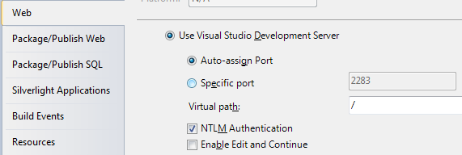
Windows Authentication (4)
The Web server should have NTLM enabled:
HTTP requests:
HTTP responses:
GET /Default.aspx HTTP/1.1
…
HTTP/1.1 401 Unauthorized
WWW-Authenticate: NTLM
GET /Default.aspx HTTP/1.1
Authorization: NTLM tESsB/ yNY3lb6a0L6vVQEZNqwQn0sqZ…
HTTP/1.1 200 OK
…
<html> … </html>
Notes:
1) NTLM Handshake

Slide 10
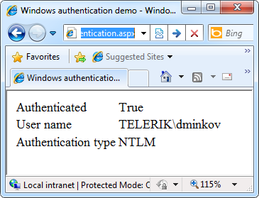
Windows Authentication
Live Demo

Slide 11
Forms Authentication
Forms Authentication uses a Web form to collect login credentials (username / password)
Users are authenticated by the C# code behind the Web form
User accounts can be stored in:
Web.config file
Separate user database
Users are local for the Web application
Not part of Windows or Active Directory
Notes:
1) Forms authentication enables you to authenticate the user name and password of your users using a login form that you create. Unauthenticated requests are redirected to a login page, where the user provides credentials and submits the form. If the application authenticates the request, the system issues a ticket that contains a key for reestablishing the identity for subsequent requests.
2) After successful authentication, the FormsAuthenticationModule module sets the value of the User property to a reference to the authenticated user.

Slide 12
Forms Authentication (2)
Enabling forms authentication:
Set authentication mode in the Web.config to "Forms"
Create a login ASPX page
Create a file or database to store the user credentials (username, password, etc.)
Write code to authenticate the users against the users file or database
<authentication mode="Forms" />

Slide 13
Configuring Authorization in Web.config
To deny someone's access add <deny users="…"> in the <authorization> tag
To allow someone's access add <allow users="…"> in the authorization tag
<deny users="?" /> denies anonymous access
<deny users="*" /> denies access to all users
<system.web>
<authorization>
<deny users="?"/>
</authorization>
</system.web>

Slide 14
Configuring Authorization in Web.config (2)
Specifying authorization rules in Web.config:
The deny/allow stops the authorization process at the first match
Example: if a user is authorized as Pesho, the tag <deny users="*" /> is not processed
<location path="RegisterUser.aspx">
<system.web>
<authorization>
<allow roles="admin" />
<allow users="Pesho,Gosho" />
<deny users="*" />
</authorization>
</system.web>
</location>

Slide 15
Implementing Login / Logout
Logging-in using credentials from Web.config:
Logging-out the currently logged user:
Displaying the currently logged user:
if (FormsAuthentication.Authenticate(username, passwd))
{
FormsAuthentication.RedirectFromLoginPage(
username, false);
}
else
{
lblError.Text = "Invalid login!";
}
This method creates a cookie (or hidden field) holding the authentication ticket.
FormsAuthentication.SignOut();
lblInfo.Text = "User: " + Page.User.Identity.Name;

Slide 16
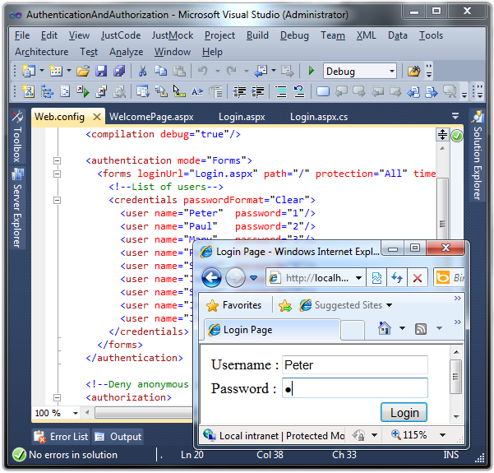
Forms Authentication
Live Demo

Slide 17

ASP.NET Users and Roles
Membership Provider and Roles Provider

Slide 18

Users, Roles and Authentication
User is a client with a Web browser running a session with the Web application
Users can authenticate (login) in the Web application
Once a user is logged-in, a set of roles and permissions are assigned to him
Authorization in ASP.NET is based on users and roles
Authorization rules specify what permissions each user / role has

Slide 19
ASP.NET Membership
Simplify common authentication and user management tasks
CreateUser()
DeleteUser()
GeneratePassword()
ValidateUser()
…
Can store user credentials in database / file / etc.
Notes:
1) ASP.NET membership gives you a built-in way to validate and store user credentials. ASP.NET membership therefore helps you manage user authentication in your Web sites. You can use ASP.NET membership with ASP.NET forms authentication by using with the ASP.NET login controls to create a complete system for authenticating users.
2) ASP.NET membership supports facilities for:
Creating new users and passwords.
Storing membership information (user names, passwords, and supporting data) in Microsoft SQL Server, Active Directory, or an alternative data store.
Authenticating users who visit your site. You can authenticate users programmatically, or you can use the ASP.NET login controls to create a complete authentication system that requires little or no code.
Managing passwords, which includes creating, changing, and resetting them . Depending on membership options you choose, the membership system can also provide an automated password-reset system that takes a user-supplied question and response.
Exposing a unique identification for authenticated users that you can use in your own applications and that also integrates with the ASP.NET personalization and role-management (authorization) systems.
Specifying a custom membership provider, which allows you to substitute your own code to manage membership and maintain membership data in a custom data store

Slide 20
Registering a Membership Provider
Adding membership provider to the Web.config
<membership defaultProvider="MyMembershipProvider">
<providers>
<add connectionStringName="UsersConnectionString"
minRequiredPasswordLength="6"
requiresQuestionAndAnswer="true"
enablePasswordRetrieval="false"
requiresUniqueEmail="false"
applicationName="/MyApp"
minRequiredNonalphanumericCharacters="1"
name="MyMembershipProvider"
type="System.Web.Security.SqlMembershipProvider"/>
</providers>
</membership>

Slide 21
Roles in ASP.NET
Roles in ASP.NET allow assigning permissions to a group of users
E.g. "Admins" role could have more privileges than "Guests" role
A user account can be assigned to multiple roles in the same time
E.g. user "Peter" can be member of "Admins" and "TrustedUsers" roles
Permissions can be granted to multiple users sharing the same role
Notes:
1) A role in ASP.NET is, essentially, a group of users. By assigning users to specified roles ( admins, managers, staff, etc. ), you can selectively control access to specified portions of your application based on roles, instead of, or in addition to, allowing or denying authorization to individual users.

Slide 22
ASP.NET Role Providers
Role providers in ASP.NET
Simplify common authorization tasks and role management tasks
CreateRole()
IsUserInRole()
GetAllRoles()
GetRolesForUser()
…
Can store user credentials in database / file / etc.

Slide 23
Registering a Role Provider
To register role provider in ASP.NET 4.0 add the following to the Web.config:
<roleManager enabled="true"
DefaultProvider="MyRoleProvider">
<providers>
<add connectionStringName="UsersConnectionString"
name="MyRoleProvider"
type="System.Web.Security.SqlRoleProvider" />
</providers>
</roleManager>
<connectionStrings>
<add name="UsersConnectionString"
connectionString="Data Source=.\SQLEXPRESS;Initial
Catalog=Users;Integrated Security=True"
providerName="System.Data.SqlClient" />
</connectionStrings>

Slide 24
The SQL Registration Tool: aspnet_regsql
The built-in classes System.Web.Security. SqlMembershipProvider and System.Web. Security.SqlRoleProvider use a set of standard tables in the SQL Server
Can be created by the ASP.NET SQL Server Registration tool (aspnet_regsql.exe)
The aspnet_regsql.exe utility is installed as part of with ASP.NET 4.0:
C:\WINDOWS\Microsoft.NET\Framework\v4.0.30319\ aspnet_regsql.exe
Notes:
1) The ASP.NET SQL Server registration tool (Aspnet_regsql.exe) is used to create a Microsoft SQL Server database that is used by the SQL Server providers in ASP.NET. The tool is also used to add or remove options from an existing database.
2) When you install ASP.NET, the Machine.config file for your server includes configuration elements that specify SQL Server providers for each of the ASP.NET features that rely on a provider. These providers are configured, by default, to connect to a local user instance of SQL Server Express. If you change the default connection string used by the providers, then before you can use any of the ASP.NET features configured in the machine configuration, you must install the SQL Server database and the database elements for your chosen feature using Aspnet_regsql.exe. If the database that you specify with Aspnet_regsql.exe does not already exist (aspnetdb will be the default database if one is not specified on the command line), then the current user must have rights to create databases in SQL Server as well as to create schema elements within a database.
3) You can run Aspnet_regsql.exe without any command-line arguments to run a wizard that will walk you through specifying connection information for your SQL Server database and installing or removing the database elements for supported features.

Slide 25
The Standard ASP.NET Applications Database Schema

Slide 26
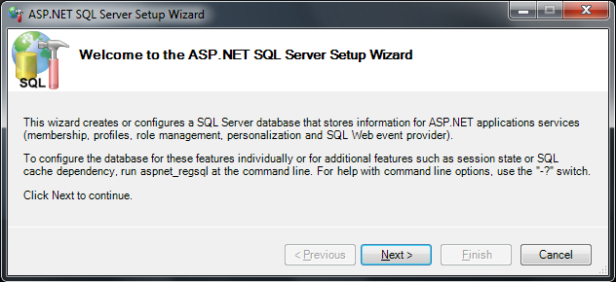
aspnet_regsql.exe
Live Demo

Slide 27
ASP.NET Membership API
Implementing login:
Implementing logout:
Creating new user:
if (Membership.ValidateUser(username, password))
{
FormsAuthentication.RedirectFromLoginPage(
username, false);
}
FormsAuthentication.SignOut();
Membership.CreateUser(username, password);

Slide 28
ASP.NET Membership API (2)
Getting the currently logged user:
Creating new role:
Adding user to existing role:
Deleting user / role:
MembershipUser currentUser = Membership.GetUser();
Roles.CreateRole("Admins");
Roles.AddUserToRole("admin", "Admins");
Membership.DeleteUser("admin", true);
Roles.DeleteRole("Admins");

Slide 29
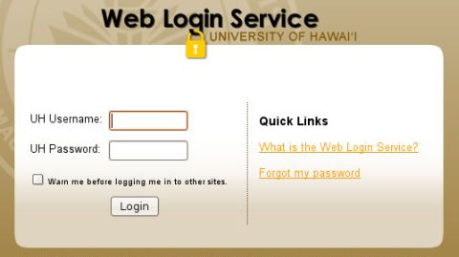
Membership Provider
Live Demo

Slide 30
ASP.NET Web Site Administration Tool
Designed to manage your Web site configuration
Simple interface
Can create and manage users, roles and providers
Can manage application configuration settings
Accessible from Visual Studio:
[Project] menu → [ASP.NET Configuration]

Slide 31
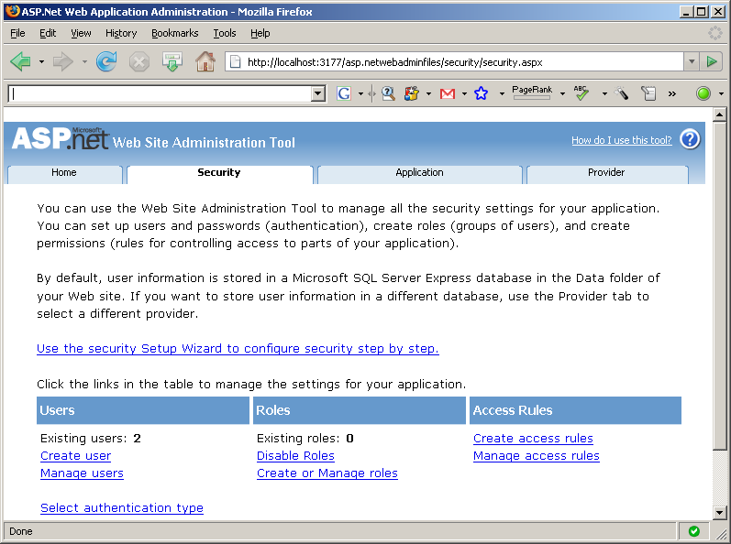
Visual Studio Web Site Administration Tool
Live Demo

Slide 32
Built-in Login Control

Slide 33
The Login Control
The Login control provides the necessary interface through which a user can enter their username and password
The control uses the membership provider specified in the Web.config file
Adding the login control to the page:
<asp:Login id="MyLogin" runat="server"/>
Notes:
1) The Login control displays a user interface for user authentication. The Login control contains text boxes for the user name and password and a check box that allows users to indicate whether they want the server to store their identity using ASP.NET membership and automatically be authenticated the next time they visit the site.
2)The Login control has properties for customized display, for customized messages, and for links to other pages where users can change their password or recover a forgotten password. The Login control can be used as a standalone control on a main or home page, or you can use it on a dedicated login page.
3) If you use the Login control with ASP.NET membership, you do not need to write code to perform authentication. However, if you want to create your own authentication logic, you can handle the Login control's Authenticate event and add custom authentication code.

Slide 34
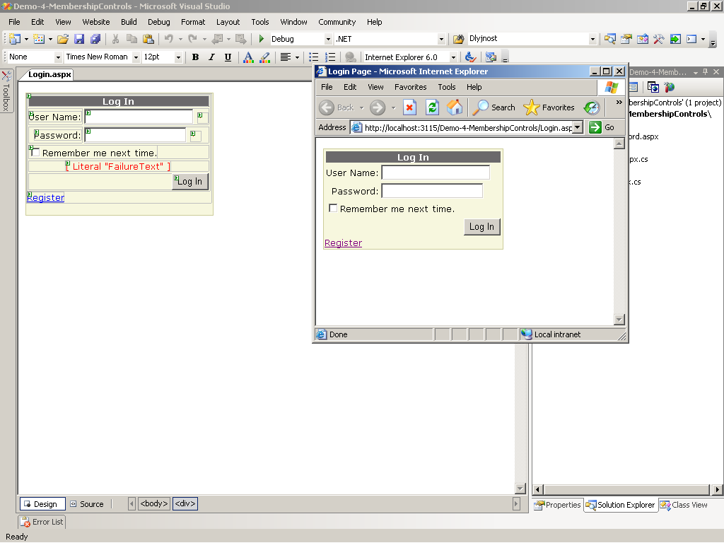
The Login Control (2)

Slide 35
The LoginName and LoginStatus Control
Once a user has logged in we can display his username just by adding the LoginName control to the page
The LoginStatus control allows the user to log in or log out of the application
<asp:LoginName id="lnUser" runat="server"/>
<asp:LoginStatus id=" lsUser" runat="server"/>
Notes:
The LoginName control displays a user's login name if the user has logged in using ASP.NET membership. Alternatively, if your site uses integrated Windows authentication, the control displays the user's Windows account name
2) The LoginStatus control displays a login link for users who are not authenticated and a logout link for users who are authenticated. The login link takes the user to a login page. The logout link resets the current user's identity to be an anonymous user.
You can customize the appearance of the LoginStatus control by setting the LoginText and LoginImageUrl properties.

Slide 36
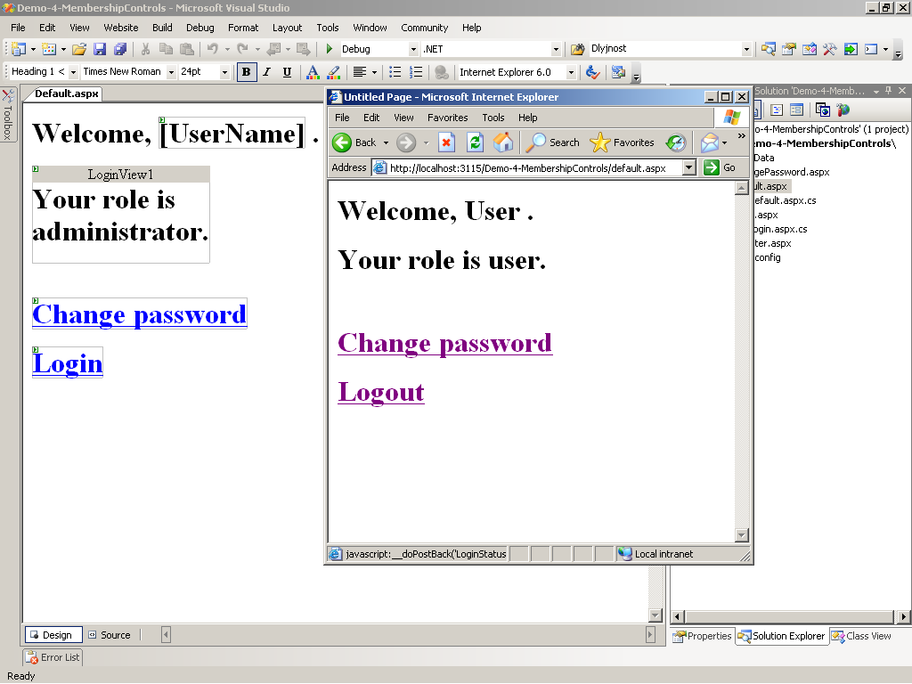
The LoginName and LoginStatus Control

Slide 37
The LoginView Control
Customized information which will be shown to users through templates, based on their roles
By default there are AnonymousTemplate and LoggedInTemplate
New custom templates can be added
To add the control to the page use:
<asp:LoginView id="MyLoginView" runat="server">
</asp:LoginView>
Notes:
The LoginView control allows you to display different information to anonymous and logged-in users. The control displays one of two templates: the AnonymousTemplate or the LoggedInTemplate. In the templates, you can add markup and controls that display information appropriate for anonymous users and authenticated users, respectively.
The LoginView control also includes events for ViewChanging and ViewChanged, which allow you to write handlers for when the user logs in and changes status.

Slide 38
The CreateUserWizard Control
It is used to create new accounts
It works with the membership provider class
Offers many customizable features
Can quickly be added to and used using
<asp:CreateUserWizard id="NewUserWiz" runat="server">
</asp:CreateUserWizard>
Notes:
1) The CreateUserWizard control collects information from potential users. By default, the CreateUserWizard control adds the new user to the ASP.NET membership system.
2) The CreateUserWizard control gathers the following user information:
User name
Password
Confirmation of password
E-mail address
Security question
Security answer

Slide 39
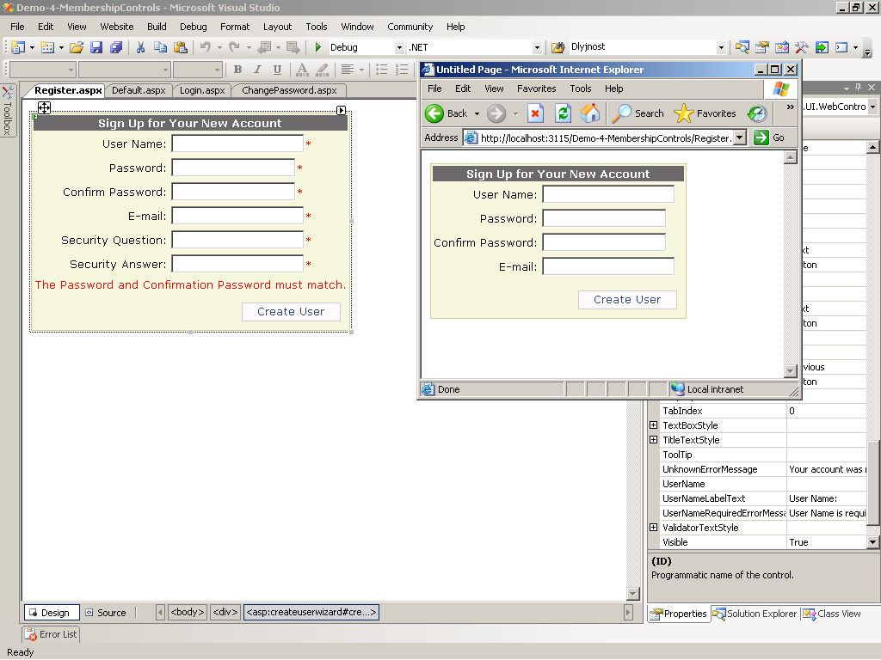
The CreateUserWizard Control (2)

Slide 40
The PasswordRecovery Control
It is used to retrieve passwords
The user is first prompted to enter username
Once users enter valid user names, they must answer their secret questions
The password is sent via e-mail
To add this control use:
<asp:PasswordRecovery id="prForgotPass" runat="server">
</asp:PasswordRecovery>
Notes:
The PasswordRecovery control allows user passwords to be retrieved based on the e-mail address that was used when the account was created. The PasswordRecovery control sends an e-mail message containing a password to the user.
You can configure ASP.NET membership to store passwords using non-reversible encryption. In that case, the PasswordRecovery control generates a new password instead of sending the original password to the user.
You can also configure membership to include a security question that the user must answer to recover a password. If you do, the PasswordRecovery control asks the question and checks the answer before recovering the password.
The PasswordRecovery control requires that your application can forward e-mail message to a Simple Mail Transfer Protocol (SMTP) server. You can customize the text and format of the e-mail message sent to the user by setting the MailDefinition property.

Slide 41
The ChangePassword Control
Allows users to change their passwords
It uses the membership provider specified in the Web.config
Can be added to any page with the following tag:
<asp:ChangePassword id="cpChangePass" runat="server"/>
Notes:
The ChangePassword control allows users to change their password. The user must first supply the original password and then create and confirm the new password. If the original password is correct, the user password is changed to the new password. The control also includes support for sending an e-mail message about the new password.
The ChangePassword control includes two templated views that are displayed to the user. The first is the ChangePasswordTemplate, which displays the user interface used to gather the data required to change the user password. The second template is the SuccessTemplate, which defines the user interface that is displayed after a user password has been successfully changed.
The ChangePassword control works with authenticated and non-authenticated users. If a user has not been authenticated, the control prompts the user for a login name. If the user is authenticated, the control populates the text box with the user's login name

Slide 42
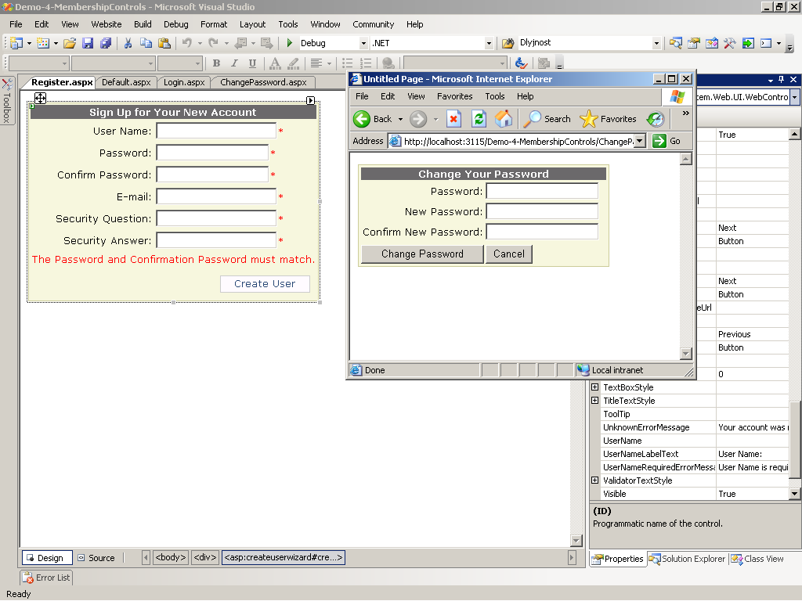
The ChangePassword Control

Slide 43

Authentication & Authorization
Questions?

Slide 44
Exercises
Create a database School in SQL Server. Using aspnet_regsql.exe add the SQL Server membership tables to support users / roles.
Using the ASP.NET Web Site Configuration Tool create a new role "Student" and two users that have the new role. Create a login page and try to enter the site with one of these two accounts.
Create a Web site and restrict access to a it for unregistered users. Implement login page, user registration page and logout link in the master page. The site should have the following pages:

Slide 45
Exercises (2)
Login.aspx – accessible to everyone
Register.aspx – accessible to everyone – allows visitors to register
Main.aspx – accessible to logged-in users only
Admin.aspx – accessible to Administrators roles only – allows users to be listed and deleted
Implement a site map and navigation menu that defines the pages in the Web site and specifies which pages which roles require. Hide the inaccessible pages from the navigation.

Slide 46
Exercises (3)
Create your own membership provider that uses a database of your choice. Define the tables:
Users(ID, username, PasswordSHA1)
Roles(ID, Name)
Create the following ASP.NET pages:
Login.aspx – accessible to everyone
Register.aspx – accessible to Administrators only
Main.aspx – accessible to logged-in users only

